Slide 1

Hamlet Goes to College
Presents
Final Presentation
Notes:
Nicole

Slide 2
Hamlet Goes to College
Team members:
Joshua Bodie
Edwin Broce
Le-Andris Daniel
Nicole Ogden – Team manager
Client:
Professor Emily Jones – Musical Theatre department
Other stakeholders:
IT department
Computer Science department
Notes:
Nicole

Slide 3
Currently
This application/audition system is mostly on paper
Students handwrite contact information
Faculty members contact students without communication to other faculty
Audition scores get lost
Information is kept in a folder with post-it notes
Notes:
Joshua

Slide 4
Summary
Computerized program to store potential theatre students’ information, such as contact, education & audition info, as well as a log of correspondence
Information stored in a database
Students enter their own information at events
Theatre and music faculty can add, edit, view, & print data
Notes:
Edwin

Slide 5
Requirements
The team agrees to satisfy the following criteria for this project:
Create a database to store information on prospective students. This includes contact information, basic high school information, degree program, and audition information.
Be able to pull up a list of students by degree program.
Be able to pull up an email list.
Keep a log of communication for each student.
Track the process of admissions. This includes status of application, audition ratings, and whether the student has visited the campus.
Allow the user to enter information at events away from campus. Since the Lindenwood network is private, this is an offline mode.
Time permitting, we will create a way to track statistics.
Notes:
Lee

Slide 6
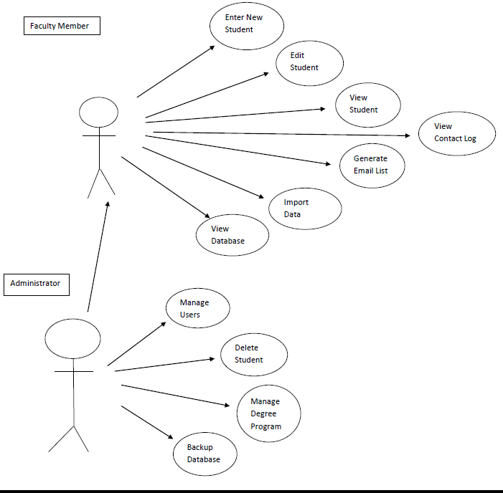
Use Case
Notes:
Joshua

Slide 7
Overview - Joshua
Show GUI
Look of forms
Mode Select form
Getting Started manual
Notes:
Joshua

Slide 8
Off-Campus Mode - Edwin
Event Form
Enter New Student
Writing to Excel file
File on Desktop
Import file on On-Campus Mode
Notes:
Edwin

Slide 9
On-Campus Mode - Lee
Change Password
Enter New Student
Edit Student
View Student
Email List
Contact Log
View Database
Notes:
Lee

Slide 10
Administrator Features - Nicole
Manage Users
Manage Degree Programs
Update Degree Program
Delete Student
Backup Database
Admin Manual
Notes:
Nicole

Slide 11
How did we do it?
Used on Windows operating systems
Microsoft Excel 2007 & later
SQL Server 2005
Microsoft Visual Studio 2008
Visual Basic – vb.net
26 Forms with 2500 lines of code
Dedicated machine in Professor Jones office holds the database
Notes:
Edwin

Slide 12
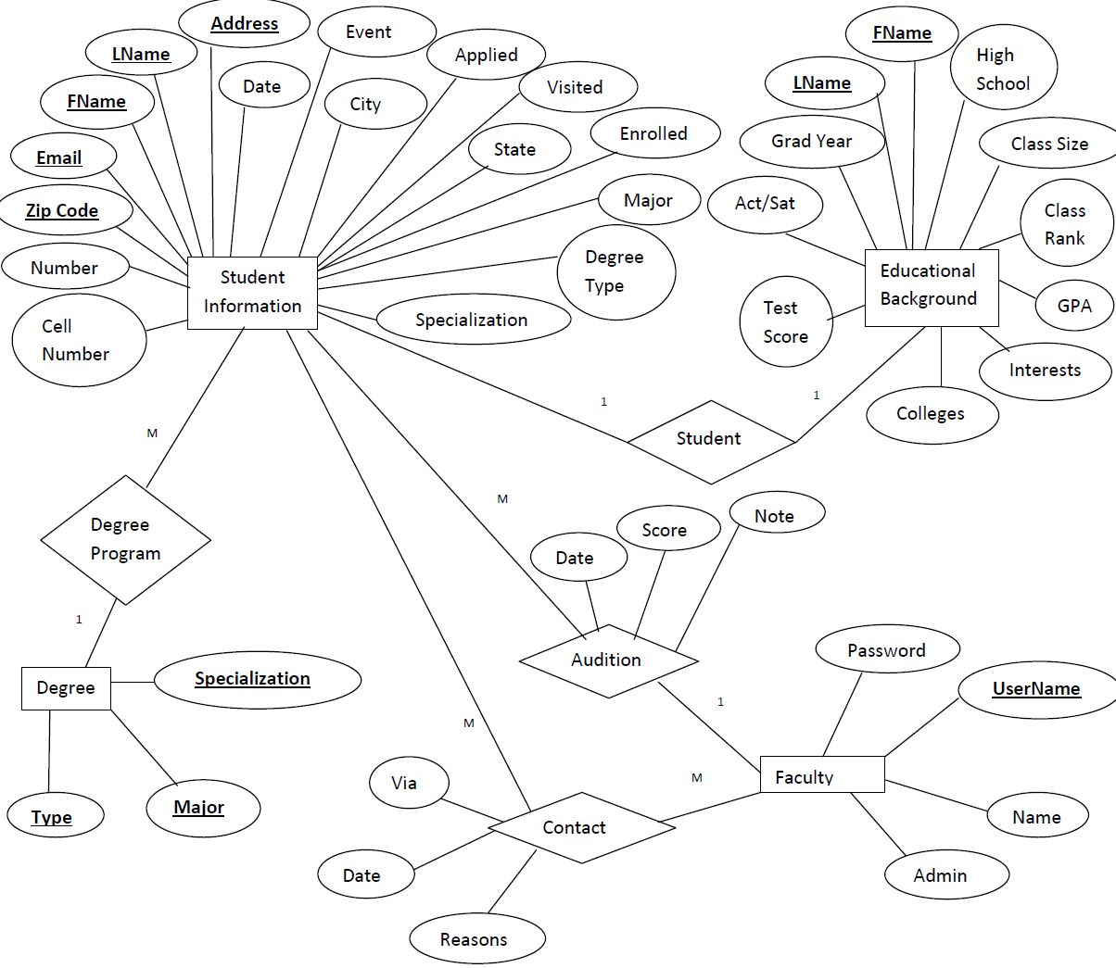
E/R Diagram
Notes:
Edwin

Slide 13
Software Engineering
Agile Model
Backlog
Used weekly scrums – a set of tasks
Scrum Leader: Nicole
Timeline
Notes:
Nicole

Slide 14
Timeline
Notes:
Nicole

Slide 15
Conflict Resolutions
Majority vote won
In the event of a tie, the person working on the task was the tie breaker
When in doubt on an issue, we contacted Professor Jones for her opinion
Notes:
Lee

Slide 16
Testing
First tested for logical cases to make sure program works.
Then tested for illogical cases that user may accidentally (or on purpose) enter to make sure the program will not crash. Helped create data validation.
Regression testing – after each addition to the program, we re-tested the entire program
Notes:
Lee

Slide 17
Deployment & Training
Will be happening Wednesday at 3pm
Guiding through the installation process & performing the install
Answering questions
Showing the user manual
How to use the SQL Management software for emergencies
Notes:
Joshua

Slide 18
Project Retrospective
Immediate successes:
Our contract is fulfilled
First GUI design was approved by client
Order of tasks in timeline
Software development plan worked (Agile model with weekly team meetings)
Software & hardware used did not change
Challenges (Learning experiences):
Crystal reports
Excel gave us trouble
Degree programs during off campus mode
Statistics not done
Notes:
Joshua

Slide 19
Questions?
Comments?

